Slide 1
Cybersecurity
Hoaxes

Slide 2
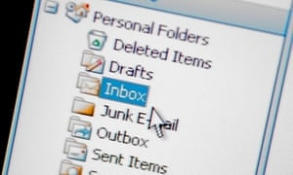
Computer Hoaxes
Not a real threat but acts like one
Can seem very real
Still a waste of time, effort
Usually come in form of an email
Pretends to be police, bank, “Federal Justice Division”
Some hoaxes seek your money
others phishing for login information
Hoaxes about viruses can waste as much time as a real virus

Slide 3
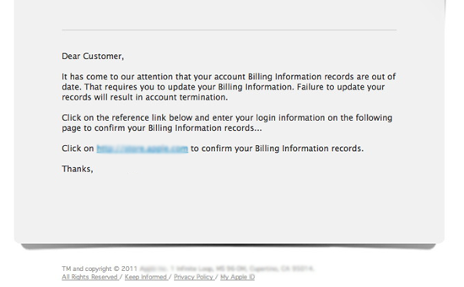
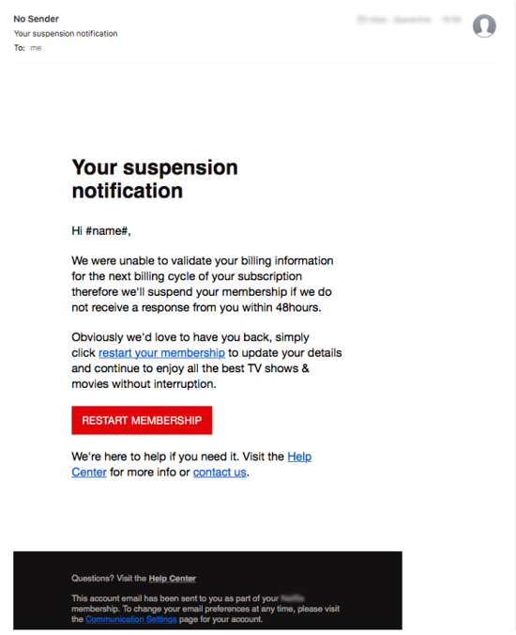
Examples

Slide 4
De-hoaxing
Don’t click on links in email
Mouseover the URL
Go directly to bank website (type it in yourself)
Verify threat
Call if you must
Check credible sources
Snopes
Spam filters usually detect recurring hoaxes

